Slide 1

Artificial Intelligence: A Modern Approach
Fourth Edition, Global Edition
Chapter 19
Learning From Examples
© 2022 Pearson Education Ltd.

Slide 2
Outline
Forms of Learning
Supervised Learning
Learning Decision Trees
Model Selection and Optimization
The Theory of Learning
Linear Regression and Classification
Nonparametric Models
Ensemble Learning
Developing Machine Learning Systems
© 2022 Pearson Education Ltd.

Slide 3
Forms of Learning
There are three types of feedback that can accompany the inputs, and that determine the three main types of learning:
Supervised Learning
agent observes input-output pairs
learns a function that maps from input to output
Unsupervised Learning
agent learns patterns in the input without any explicit feedback
clustering
Reinforcement Learning
agent learns from a series of reinforcements: rewards & punishments

Slide 4
Supervised Learning
There are three types of feedback that can accompany the inputs, and that determine the three main types of learning:
Supervised Learning
agent observes input-output pairs
learns a function that maps from input to output
Unsupervised Learning
agent learns patterns in the input without any explicit feedback
clustering
Reinforcement Learning
agent learns from a series of reinforcements: rewards & punishments

Slide 5
Supervised Learning
Training set of examples of input output (N)
(x₁, y₁), (x₂, y₂), . . . (x_{N}, y_{N}) ,
y = f (x),
function h is hypothesis about the world, approximates the true function f
drawn from a hypothesis space H of possible functions
h Model of the data, drawn from a model class H
Consistent hypothesis: an h such that each x_{i} in the training set has h(x_{i}) = y_{i}.
look for a best-fit function for which each h(x_{i}) is close to y_{i}
The true measure of a hypothesis, depends on how well it handles inputs it has not yet seen. Eg: a second sample of (x_{i}, y_{i})
h generalizes well if it accurately predicts the outputs of the test set

Slide 6
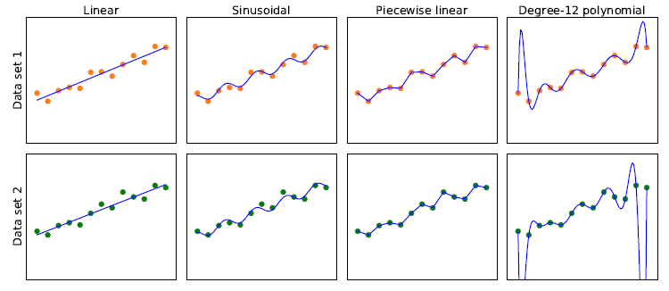
Supervised Learning
Finding hypotheses to fit data.
Top row: four plots of best-fit functions from four different hypothesis spaces trained on data set 1.
Bottom row: the same four functions, but trained on a slightly different data set (sampled from the same f (x) function).

Slide 7
Supervised Learning
Use bias to analyze hypothesis space
the tendency of a predictive hypothesis to deviate from the expected value when averaged over different training set
Underfitting: fails to find a pattern in the data
Variance: the amount of change in the hypothesis due to fluctuation in the training data.
Overfitting: when it pays too much attention to the particular data set it is trained on, causing it to perform poorly on unseen data.
Bias–variance tradeoff: a choice between more complex, low-bias hypotheses that fit the training data well and simpler, low-variance hypotheses that may generalize better.

Slide 8
Supervised Learning
Determine how probable a hypothesis is not just if possible
hypothesis h∗ that is most probable given the data:
h∗ =argmax P(h|data)
h∈H
By Bayes’ rule this is equivalent to
h∗ =argmax P(h|data) P(h)

Slide 9
Supervised Learning
Example problem: Restaurant waiting
the problem of deciding whether to wait for a table at a restaurant.
For this problem the output, y, is a Boolean variable that we will call WillWait.
The input, x, is a vector of ten attribute values, each of which has discrete values:
Alternate: whether there is a suitable alternative restaurant nearby.
Bar: whether the restaurant has a comfortable bar area to wait in.
Fri/Sat: true on Fridays and Saturdays.
Hungry: whether we are hungry right now.
Patrons: how many people are in the restaurant (values are None, Some, and Full).
Price: the restaurant’s price range ($, $$, $$$).
Raining: whether it is raining outside.
Reservation: whether we made a reservation.
Type: the kind of restaurant (French, Italian, Thai, or burger).
WaitEstimate: host’s wait estimate: 0–10, 10–30, 30–60, or >60minutes

Slide 10
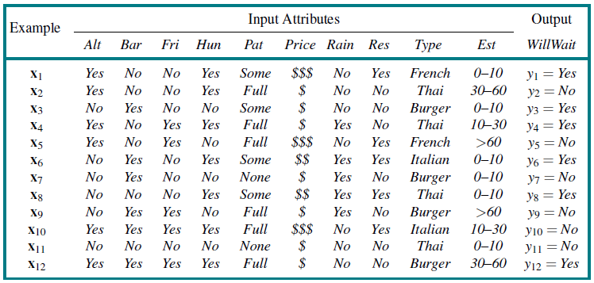
Supervised Learning
Examples for the restaurant domain.

Slide 11
Decision Trees
A decision tree is a representation of a function that maps a vector of attribute values to a single output value—a “decision.”
reaches its decision by performing a sequence of tests, starting at the root and following the appropriate branch until a leaf is reached.
each internal node in the tree corresponds to a test of the value of one of the input attributes
the branches from the node are labeled with the possible values of the attribute,
the leaf nodes specify what value is to be returned by the function.
Boolean decision tree is equivalent to a logical statement of the form:
Output ⇔ (Path₁ ∨ Path₂ ∨···)

Slide 12
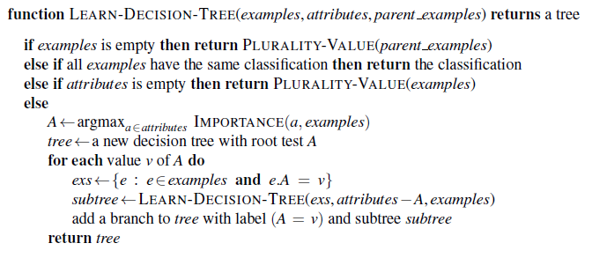
Decision Trees
The decision tree learning algorithm. The function PLURALITY-VALUE selects the most common output value among a set of examples, breaking ties randomly.
Aim: find a small tree consistent with the training examples
Idea: (recursively) choose “most significant” attribute as root of (sub)tree

Slide 13
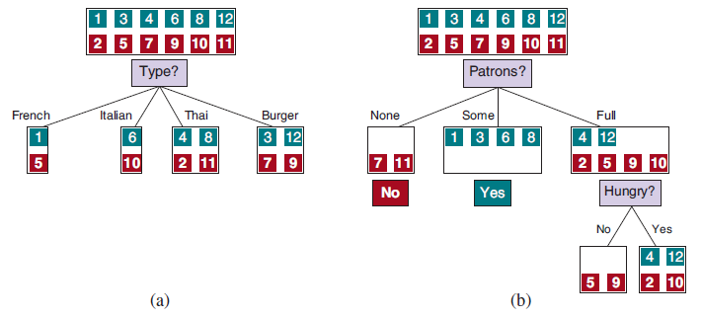
Decision Trees
Splitting the examples by testing on attributes. At each node we show the positive (light boxes) and negative (dark boxes) examples remaining.
Splitting on Type brings us no nearer to distinguishing between positive and negative examples.
Splitting on Patrons does a good job of separating positive and negative examples. After splitting on Patrons, Hungry is a fairly good second test

Slide 14
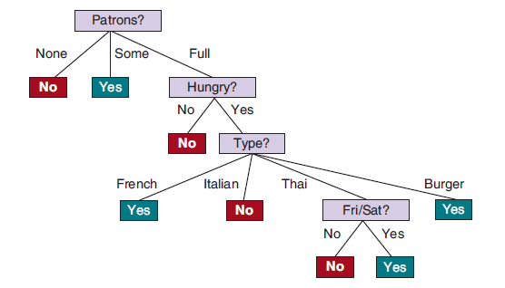
Decision Trees
The decision tree induced from the 12-example training set.

Slide 15
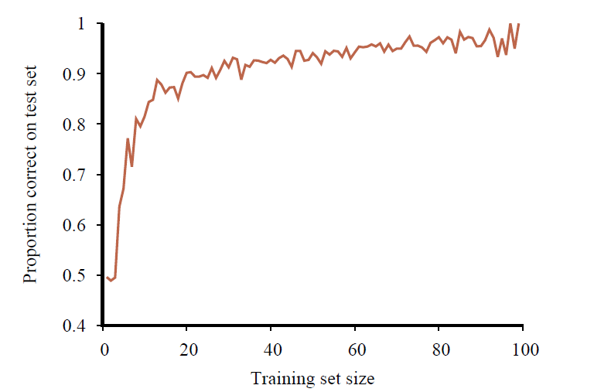
Decision Trees
The learning curve for the decision tree learning algorithm on 100 randomly generated examples in the restaurant domain. Each data point is the average of 20 trials.

Slide 16


Decision Trees
Choosing attribute tests
Entropy: measure of the uncertainty of a random variable;
the more information, the less entropy
fundamental quantity in information theory
In general, the entropy of a random variable V with values v_{k} having probability
The information gain from the attribute test on A is the expected reduction in entropy:

Slide 17


Decision Trees
Decision tree pruning helps combat overfitting
Eliminating nodes that are not clearly relevant
How large a gain should we require in order to split on a particular attribute?
Significance test
Start with null hypothesis
Calculate extent data deviates from perfect absence of pattern
degree of deviation is statistically unlikely (<=5% probability)
node consisting of p positive and n negative examples. expected numbers, pˆ_{k} and nˆ_{k},
Measure deviation & total deviation

Slide 18
Decision Trees
Broadening the applicability of decision trees
Decision trees can be made more widely useful by handling the following complications:
Missing data
Continuous and multivalued input attributes
Continuous-valued output attribute
Decision trees are also unstable in that adding just one new example can change the test at the root, which changes the entire tree

Slide 19
Model Selection and Optimization
Task of finding a good hypothesis as two subtasks:
Model selection: model selection chooses a good hypothesis space
Optimization (training) finds the best hypothesis within that space.
A training set to create the hypothesis, and a test set to evaluate it.
Error rate: the proportion of times that h(x) /= y for an (x, y)
Three data sets are needed:
A training set to train candidate models.
A validation set, also known as a development set or dev set, to evaluate the candidate models and choose the best one.
A test set to do a final unbiased evaluation of the best model.
When insufficient amount of data to create three sets: k-fold cross-validation
split the data into k equal subsets
perform k rounds of learning
on each round 1/k of the data are held out as a validation set and the remaining examples are used as the training set.
Popular values for k are 5 & 10
leave-one-out cross-validation or LOOCV, k=n

Slide 20
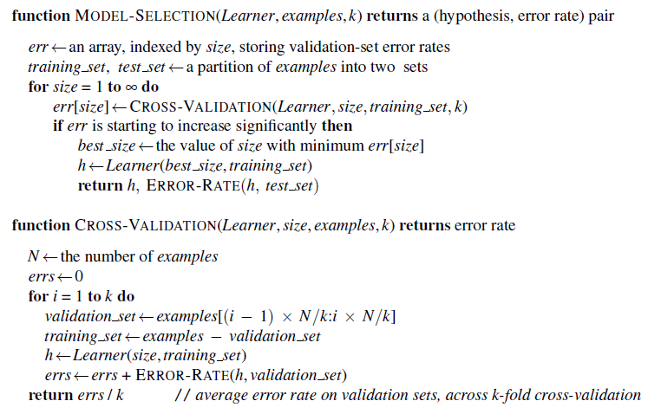
Model Selection and Optimization
An algorithm to select the model that has the lowest validation error. It builds models of increasing complexity, and choosing the one with best empirical error rate, err, on the validation data set. Learner(size, examples) returns a hypothesis whose complexity is set by the parameter size, and which is trained on examples. In CROSS-VALIDATION, each iteration of the for loop selects a different slice of the examples as the validation set, and keeps the other examples as the training set. It then returns the average validation set error over all the folds. Once we have determined which value of the size parameter is best, MODEL-SELECTION returns the model (i.e., learner/hypothesis) of that size, trained on all the training examples, along with its error rate on the held-out test examples.

Slide 21
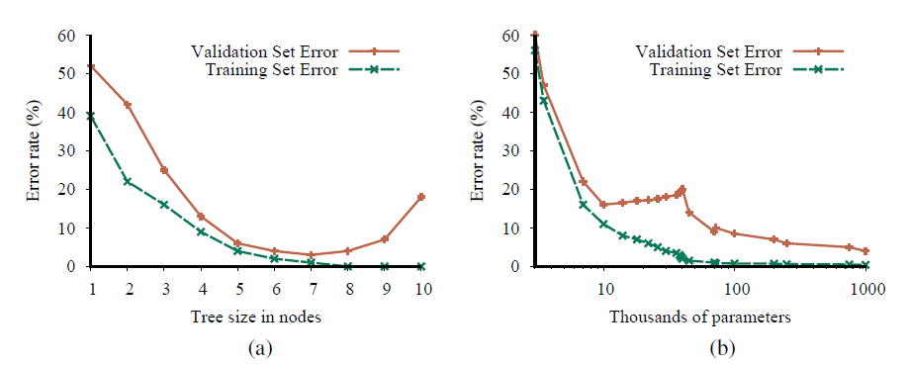
Model Selection and Optimization
Error rates on training data (lower, green line) and validation data (upper, orange line) for models of different complexity on two different problems. MODEL-SELECTION picks the hyperparameter value with the lowest validation-set error. In (a) the model class is decision trees and the hyperparameter is the number of nodes. The data is from a version of the restaurant problem. The optimal size is 7. In (b) the model class is convolutional neural networks (see Section 22.3) and the hyperparameter is the number of regular parameters in the network. The data is the MNIST data set of images of digits; the task is to identify eachdigit. The optimal number of parameters is 1,000,000 (note the log scale).

Slide 22

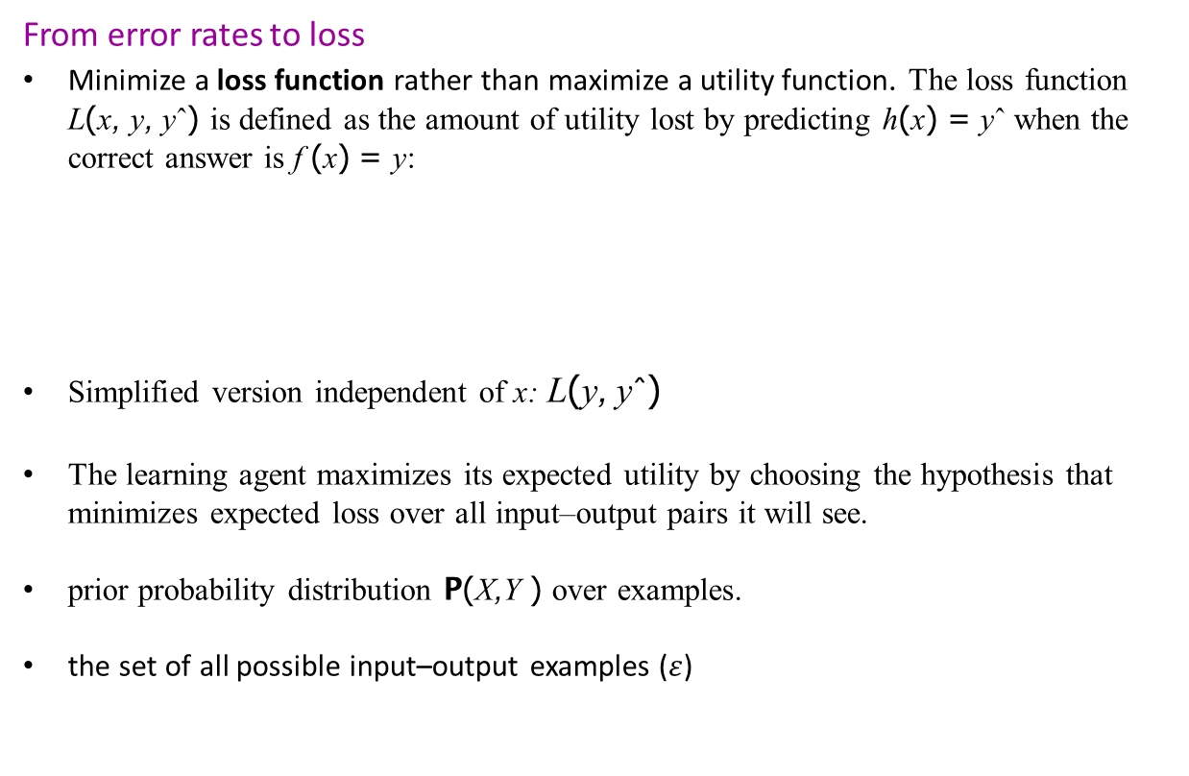
Model Selection and Optimization
From error rates to loss
Minimize a loss function rather than maximize a utility function. The loss function L(x, y, yˆ) is defined as the amount of utility lost by predicting h(x) = yˆ when the correct answer is f (x) = y:
Simplified version independent of x: L(y, yˆ)
The learning agent maximizes its expected utility by choosing the hypothesis that minimizes expected loss over all input–output pairs it will see.
prior probability distribution P(X,Y ) over examples.
the set of all possible input–output examples ($ε$)

Slide 23



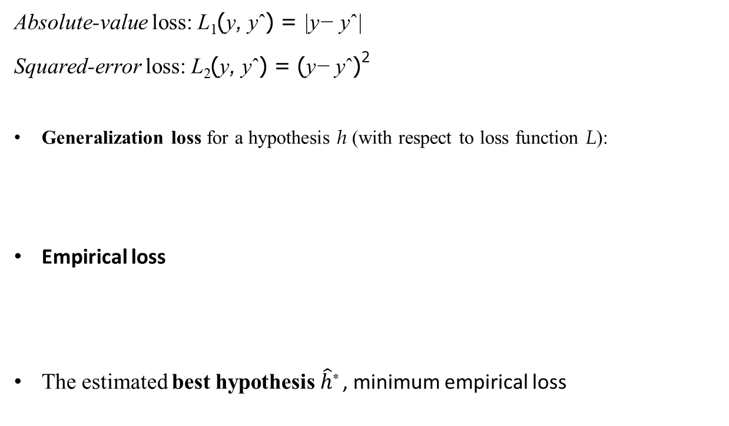
Model Selection and Optimization
Absolute-value loss: L₁(y, yˆ) = |y− yˆ|
Squared-error loss: L₂(y, yˆ) = (y− yˆ)²
Generalization loss for a hypothesis h (with respect to loss function L):
Empirical loss
The estimated best hypothesis $\hat{h}$* , minimum empirical loss

Slide 24

Model Selection and Optimization
Regularization
process of explicitly penalizing complex
minimizes the weighted sum of empirical loss and the complexity of the hypothesis
Complexity of the hypothesis
The choice of regularization function depends on the hypothesis space.
Feature selection:
reduce the dimensions that the models work with
discard attributes that appear to be irrelevant

Slide 25
Model Selection and Optimization
Hyperparameter tuning
Hand-tuning: guess parameter values based on history, repeat until satisfactory performance
Grid search: try all combinations of values and see which performs best on the validation data (small number of possible values)
Random search
Bayesian optimization: treats the task of choosing good hyperparameter values AS A machine learning problem
Population-based training (PBT)

Slide 26

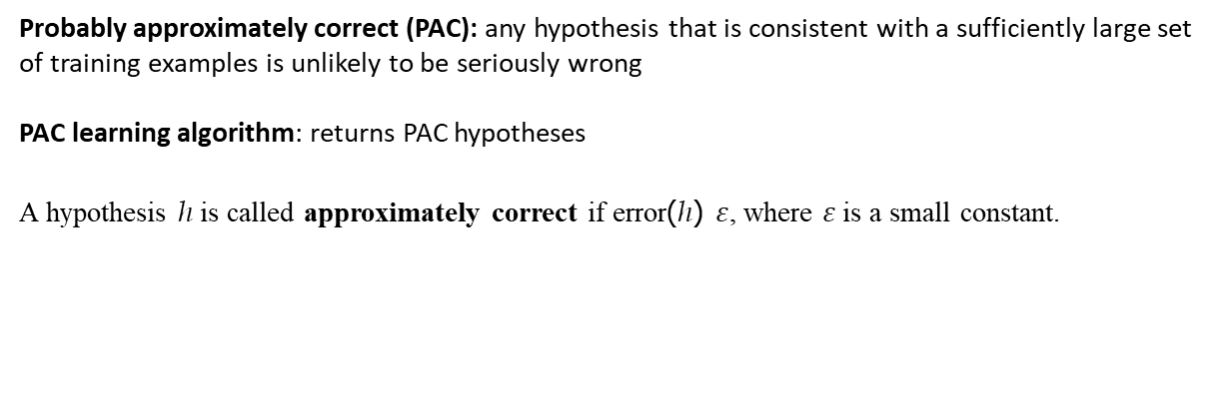
The Theory of Learning
Probably approximately correct (PAC): any hypothesis that is consistent with a sufficiently large set of training examples is unlikely to be seriously wrong
PAC learning algorithm: returns PAC hypotheses
A hypothesis h is called approximately correct if error(h) $ε$, where $ε$ is a small constant.

Slide 27
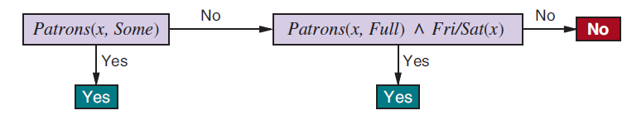



The Theory of Learning
Example of decision lists
WillWait ⇔ (Patrons = Some) ∨ (Patrons = Full ∧ Fri/Sat) .

Slide 28
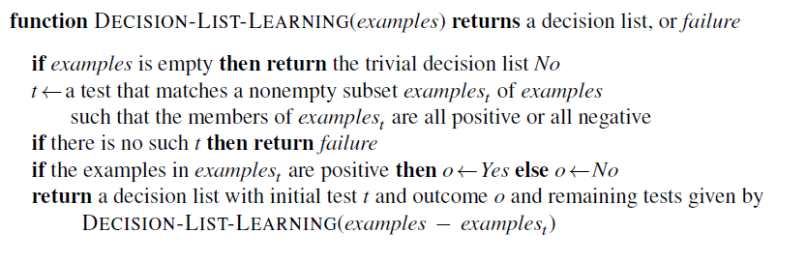
The Theory of Learning
An algorithm for learning decision lists

Slide 29
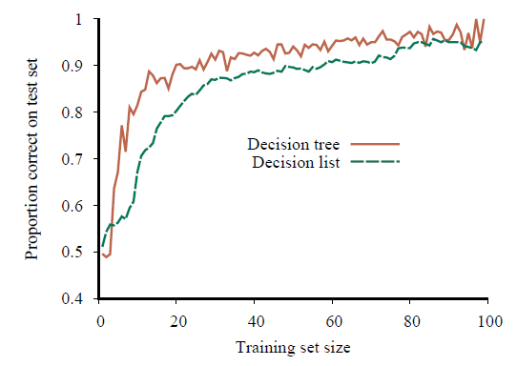
The Theory of Learning
Learning curve for DECISION-LIST-LEARNING algorithm on the restaurant data. The curve for LEARN-DECISION-TREE is shown for comparison; decision trees do slightly better on this particular problem

Slide 30



Linear Regression and Classification
Univariate linear regression
Input x and output y
y = w₁x + w₀
Linear function
h_{w}(x) = w₁x + w₀
Linear regression: finding the h_{w} that best fits these data is
Find the values of the weights (w₀, w₁) that minimize the empirical loss.
Squared-error loss function, L₂, summed over all the training examples:

Slide 31
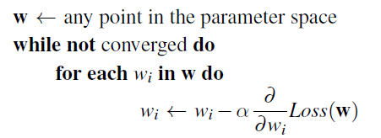
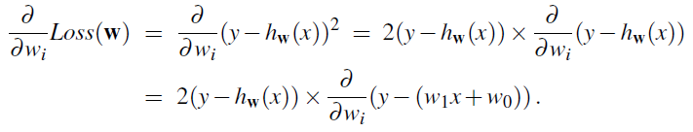


Linear Regression and Classification
Gradient descent
search through a continuous weight space by incrementally modifying the parameters (minimizing loss)
α: step size/learning rate that can be a fixed constant or decay over time

Slide 32
Linear Regression and Classification
Batch gradient descent
minimize the sum of the individual losses
The loss surface is convex,
no local minima to get stuck in, and convergence to the global minimum is guaranteed
As long α is not too large, overshoots.
Epoch: step that covers all the training examples
Stochastic gradient descent or SGD
it randomly selects a small number of training examples at each step
select a minibatch of m out of the N examples.
choose m to take advantage of parallel vector operations,

Slide 33




Linear Regression and Classification
Multivariable linear regression
x _{j} is an n-element vector
h : dot product of the weights and the input vector
Best vector of weights, w∗,:minimizes squared-error loss
Gradient descent will reach the (unique) minimum of the loss function; the update equation for each weight w_{i}

Slide 34
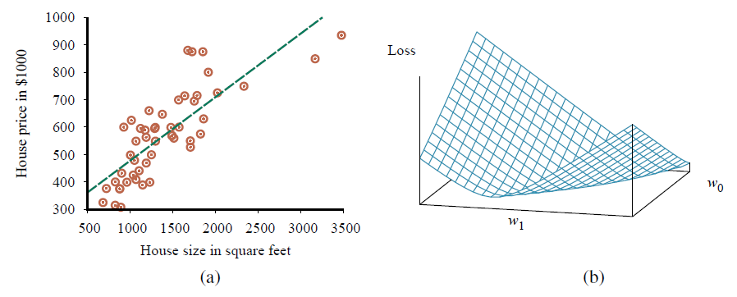
Linear Regression and Classification
Data points of price versus floor space of houses for sale in Berkeley, CA, in July 2009, along with the linear function hypothesis that minimizes squared-error loss: y = 0.232x + 246.
Plot of the loss function ∑_{j}(y _{j} − w₁x _{j} + w₀)² for various values of w₀, w₁. Note that the loss function is convex, with a single global minimum.

Slide 35
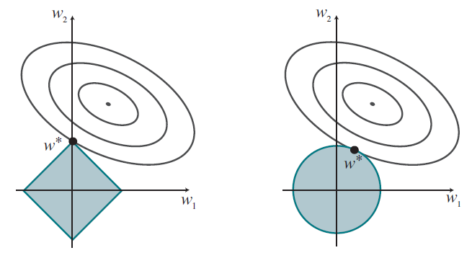
Linear Regression and Classification
Why L₁ regularization tends to produce a sparse model. Left: With L₁ regularization (box), the minimal achievable loss (concentric contours) often occurs on an axis, meaning a weight of zero. Right: With L₂ regularization (circle), the minimal loss is likely to occur anywhere on the circle, giving no preference to zero weights.

Slide 36
Linear Regression and Classification
Linear classifiers with a hard threshold
Linear functions can be used to do classification as well as regression.
Decision boundary: a line (or a surface, in higher dimensions) that separates the two classes.
Linear separator: linear decision boundary for linearly separable data
h: result of passing the linear function w · x through a threshold function:
h_{w}(x) = Threshold(w · x) where Threshold(z) = 1 if z ≥ 0 and 0 otherwise.
Possibilities of outputs for weight update during training:
Correct output: weight unchanged
y is 1 but h_{w}(x) is 0: w_{i} is increased when the corresponding input x_{i} is positive and decreased when x_{i} is negative.
y is 0 but h_{w}(x) is 1: w_{i} is decreased when the corresponding input x_{i} is positive and increased when x_{i} is negative.

Slide 37
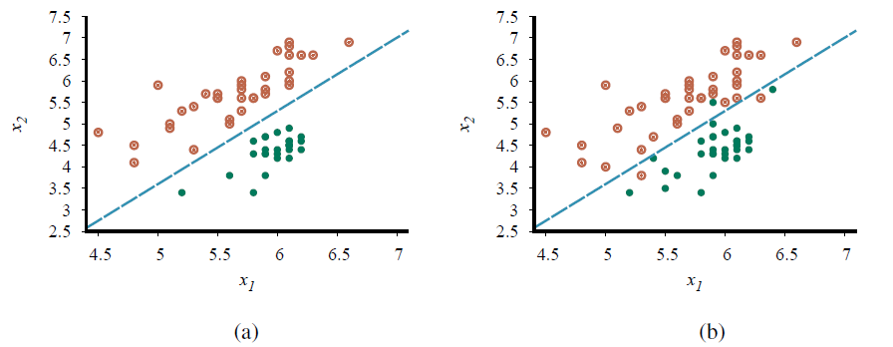
Linear Regression and Classification
Plot of two seismic data parameters, body wave magnitude x₁ and surface wave magnitude x₂, for earthquakes (open orange circles) and nuclear explosions (green circles) occurring between 1982 and 1990 in Asia and the Middle East. Also shown is a decision boundary between the classes.
The same domain with more data es and explosions are no longer linearly separable.

Slide 38
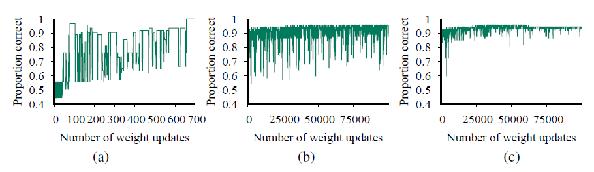
Linear Regression and Classification
(a) Plot of total training-set accuracy vs. number of iterations through the
training set for the perceptron learning rule.
(b) The same plot for the noisy, nonseparable data; note the change in scale of the x-axis.
(c) The same plot as in (b), with a learning rate schedule α(t) = 1000/(1000 + t ).

Slide 39


Linear Regression and Classification
Linear classification with logistic regression
softening the threshold function— approximating the hard threshold with a continuous, differentiable function
Logistic function:
Used to replace the threshold function:
Logistic regression: process of fitting the weights of this model to minimize loss on a data set

Slide 40
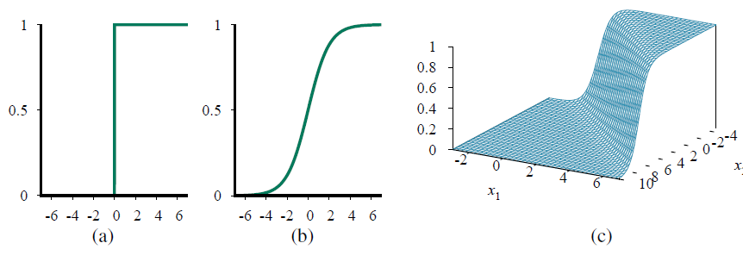
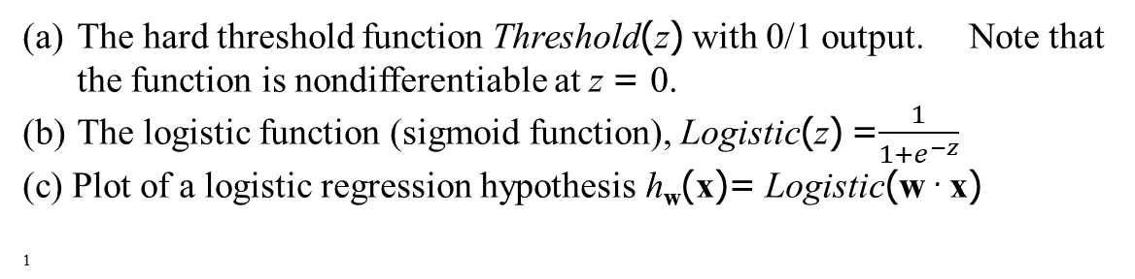
Linear Regression and Classification
The hard threshold function Threshold(z) with 0/1 output. Note that the function is nondifferentiable at z = 0.
The logistic function (sigmoid function), Logistic(z) =$\frac{1}{1+e^{−z}}$
(c) Plot of a logistic regression hypothesis h_{w}(x)= Logistic(w · x)
1

Slide 41
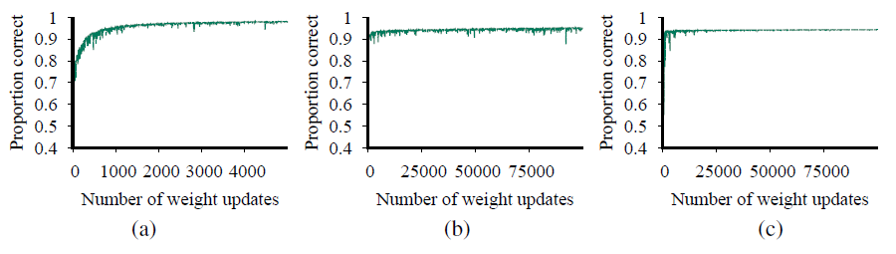
Linear Regression and Classification
Logistic regression on previous data. The plot in (a) covers 5000 iterations rather than 700, while the plots in (b) and (c) use the same scale as before.)
1

Slide 42
Nonparametric Models
Parametric model: learning model that summarizes data with a set of parameters of fixed size (independent of the number of training examples)
Nonparametric model: model that cannot be characterized by a bounded set of parameters
One example piecewise linear function that retains all the data points as
part of the model. (instance-based learning or memory-based learning)
Simplest instance-based learning method: table lookup
take all the training examples, put them in a lookup table, and then when asked for h(x), see if x is in the table; if it is, return the corresponding y.

Slide 43

Nonparametric Models
Nearest-neighbor models
k-nearest-neighbors
given a query x_{q}, instead of finding an example that is equal to x_{q}, find the k examples that are nearest to x_{q}.
set of k neighbors nearest to x_{q} . = NN(k, x_{q})
for example, if k = 3 and the output values are Yes, No, Yes , then the classification will be Yes.
To avoid ties on binary classification, k is usually chosen as an odd number.
Measure the distance from a query point x_{q} to an example point x _{j} using Minkowski distance or L^{p}
p =2, Euclidean distance
p =1, Manhattan distance
Boolean attribute values, Hamming distance
Mahalanobis distance: takes into account the covariance between dimensions.

Slide 44
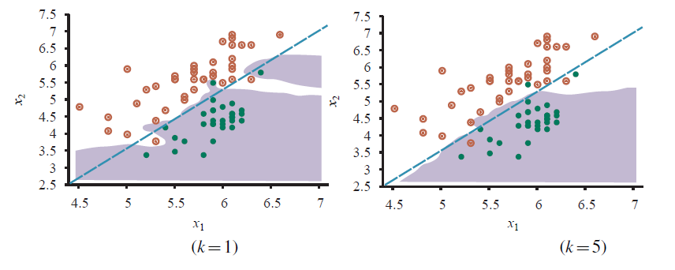
Nonparametric Models
A k-nearest-neighbors model showing the extent of the explosion class for previously used data, with k = 1. Overfitting is apparent.
k = 5, the overfitting problem goes away for this data set.

Slide 45
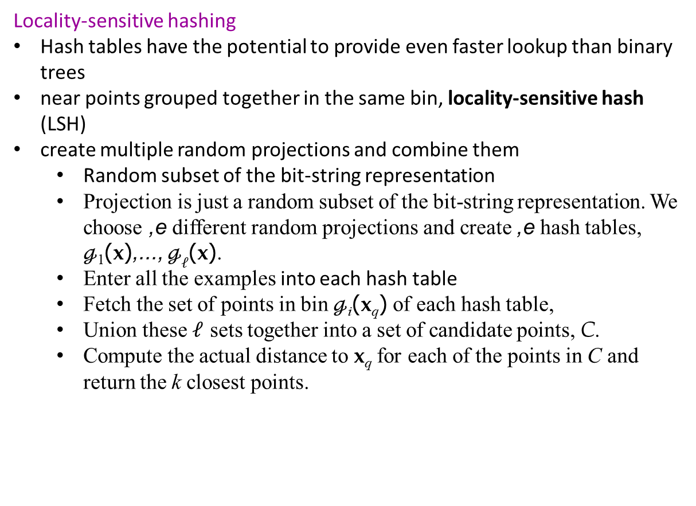
Nonparametric Models
Locality-sensitive hashing
Hash tables have the potential to provide even faster lookup than binary trees
near points grouped together in the same bin, locality-sensitive hash (LSH)
create multiple random projections and combine them
Random subset of the bit-string representation
Projection is just a random subset of the bit-string representation. We choose ,e different random projections and create ,e hash tables, $ℊ$₁(x),..., $ℊℓ$(x).
Enter all the examples into each hash table
Fetch the set of points in bin $ℊ$_{i}(x_{q}) of each hash table,
Union these $ℓ$ sets together into a set of candidate points, C.
Compute the actual distance to x_{q} for each of the points in C and return the k closest points.

Slide 46

Nonparametric Models
Nonparametric regression
k-nearest-neighbors regression improves on connect-the-dots.
Locally weighted regression: gives us the advantages of nearest neighbors without the discontinuities
at each query point x_{q}, the examples that are close to x_{q} are weighted heavily, and the examples that are farther away are weighted less heavily, and the farthest not at all.
decide how much to weight each example with a function known as a kernel, whose input is a distance between the query point and the example

Slide 47
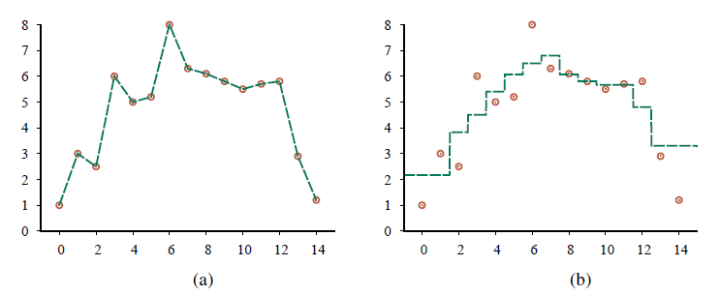
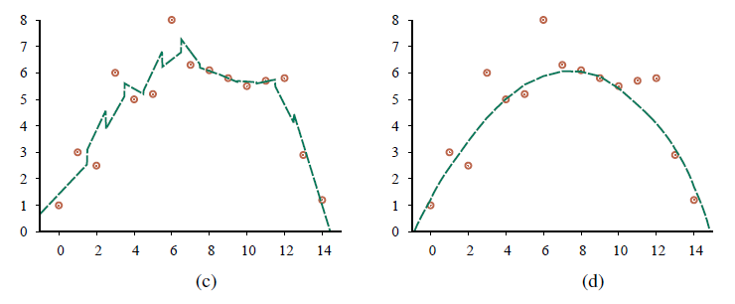
Nonparametric Models
Nonparametric regression models: (a) connect the dots, (b) 3-nearest neighbors average, (c) 3-nearest-nei hbors linear regression, (d) locally weighted regression with a quadratic kernel of width 10.

Slide 48
Nonparametric Models
Support vector machines (SVM)
SVMs retain three attractive properties over deep learning networks and random forests:
SVMs construct a maximum margin separator
a decision boundary with the largest possible distance to example points
SVMs create a linear separating hyperplane,
SVMs are nonparametric
the separating hyperplane is defined by a set of example
Instead of minimizing expected empirical loss on the training data, SVMs attempt to minimize expected generalization loss.

Slide 49

Nonparametric Models
The separator between points is defined as the set of points {x : w · x + b = 0}.
Optimal solution is found by solving
Expression is convex; it has a single global maximum that can be found efficiently.
The data enter the expression only in the form of dot products of pairs of points
A final important property is that the weights α_{j} associated with each data point are zero except for the support vectors—the points closest to the separator.

Slide 50
Nonparametric Models
The kernel trick
Plugging kernel into equation below, optimal linear separators can be found
The resulting linear separators, when mapped back to the original input space, can correspond to arbitrarily wiggly, nonlinear decision boundaries between the positive and negative examples.
The kernel method can be applied with any other algorithm that can be reformulated to work only with dot products of pairs of data points (kernelized version of the algorithm)

Slide 51
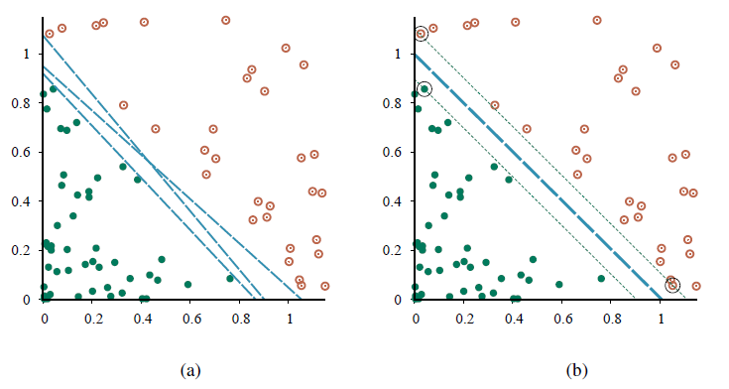
Nonparametric Models
Support vector machine classification:
Two classes of points (orange open and green filled circles) and three candidate linear separators.
The maximum margin separator (heavy line), is at the midpoint of the margin (area between dashed lines). The support vectors (points with large black circles) are the examples closest to the separator;here there are three.

Slide 52
Ensemble Learning
The idea of ensemble learning is to select a collection, or ensemble, of hypotheses, h₁, h₂, . . . , h_{n}, and combine their predictions by averaging, voting, or by another level of machine learning
individual hypotheses: base models
Combination of base models: Ensemble models
Reasons to do ensemble learning
Reduce bias, ensemble can be more expressive thus less bias than base models
Reduce variance, it is hoped it is less likely multiple classifiers will misclassify

Slide 53

Ensemble Learning
Bagging
generate K distinct training sets by sampling with replacement from the original training set.
randomly pick N examples from the training set, but each of those picks might be an example picked before.
run our machine learning algorithm on the N examples to get a hypothesis
repeat this process K times, getting K different hypotheses
aggregate the predictions from all K hypotheses.
for classification problems, that means taking the plurality vote (the majority vote for binary classification).
for regression problems, the final output is the average of hypotheses:

Slide 54
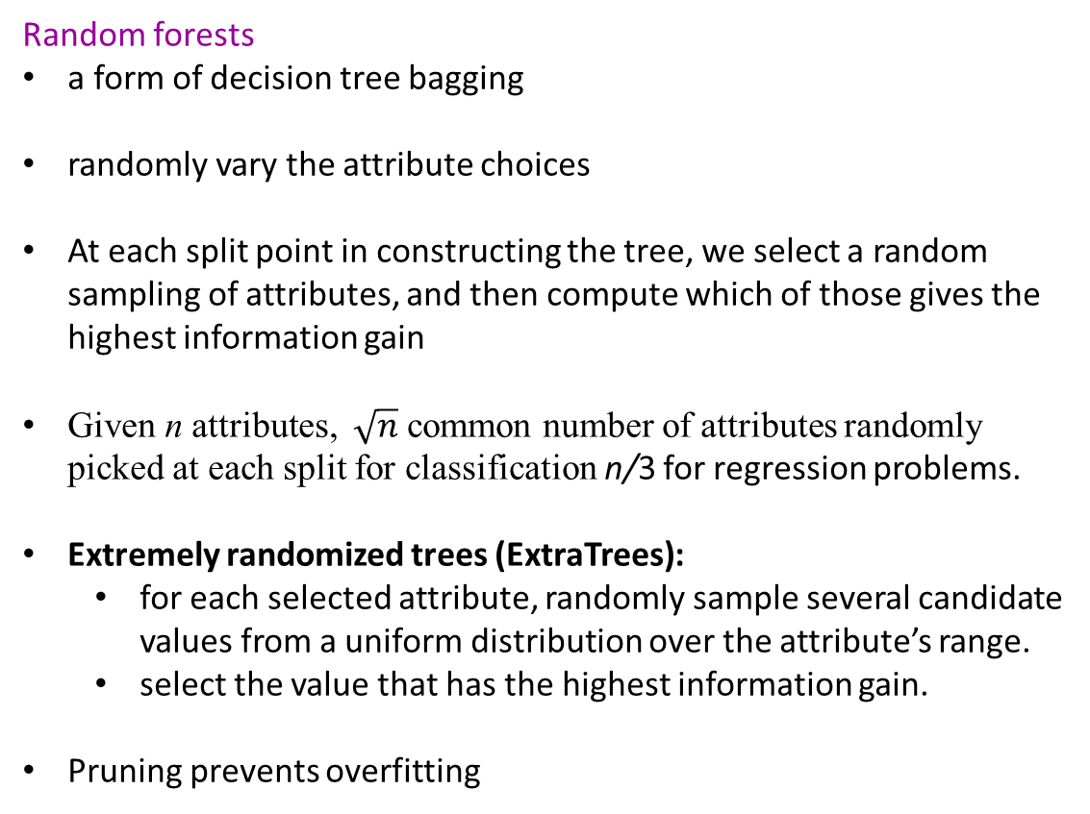
Ensemble Learning
Random forests
a form of decision tree bagging
randomly vary the attribute choices
At each split point in constructing the tree, we select a random sampling of attributes, and then compute which of those gives the highest information gain
Given n attributes, $\sqrt{n}$ common number of attributes randomly picked at each split for classification n/3 for regression problems.
Extremely randomized trees (ExtraTrees):
for each selected attribute, randomly sample several candidate values from a uniform distribution over the attribute’s range.
select the value that has the highest information gain.
Pruning prevents overfitting

Slide 55
Ensemble Learning
Stacking
combines multiple base models from different model classes trained on the same data
approach:
use the same training data to train each of the base models,
use the held-out validation data (plus predictions) to train the ensemble model.
Also possible to use cross-validation if desired.
can be thought of as a layer of base models with an ensemble model stacked above it, operating on the output of the base models

Slide 56

Ensemble Learning
Boosting
weighted training set: each example has an associated weight w_{j} ≥ 0 that describes how much the example should count during training.
Start with first hypothesis h₁.
increase their weights while decreasing the weights of the correctly classified examples.
process continues in this way until we have generated K hypotheses, where K is an input to the boosting algorithm.
Similar to a Greedy algorithm in the sense that it does not backtrack; once it has chosen a hypothesis h_{i} it will never undo that choice; rather it will add new hypotheses

Slide 57
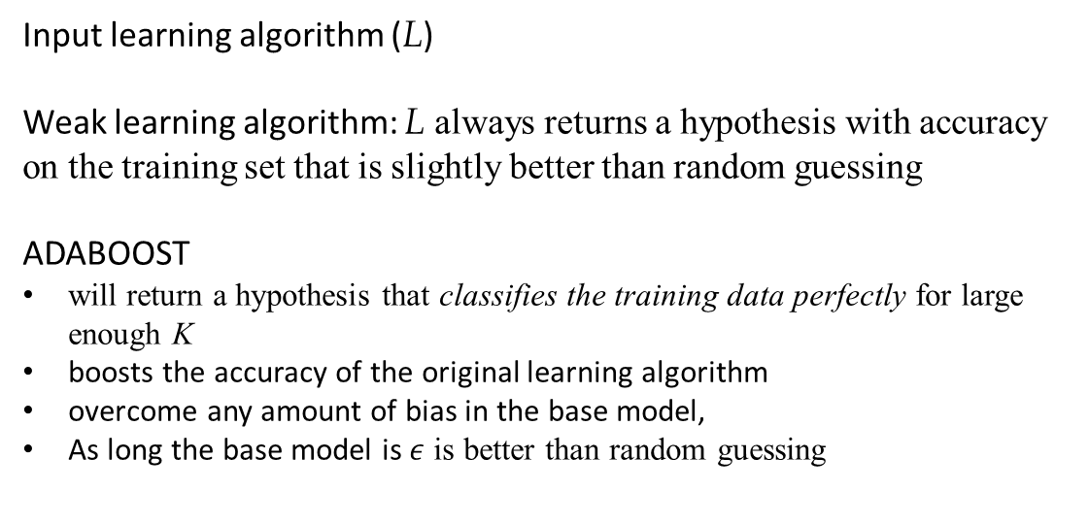
Ensemble Learning
Input learning algorithm (L)
Weak learning algorithm: L always returns a hypothesis with accuracy on the training set that is slightly better than random guessing
ADABOOST
will return a hypothesis that classifies the training data perfectly for large enough K
boosts the accuracy of the original learning algorithm
overcome any amount of bias in the base model,
As long the base model is $ε$ is better than random guessing

Slide 58
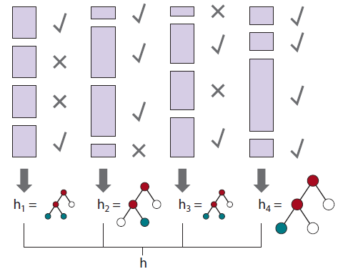
Ensemble Learning
How the boosting algorithm works. Each shaded rectangle corresponds to an example; the height of the rectangle corresponds to the weight. The checks and crosses indicate whether the example was classified correctly by the current hypothesis. The size of the decision tree indicates the weight of that hypothesis in the final ensemble

Slide 59
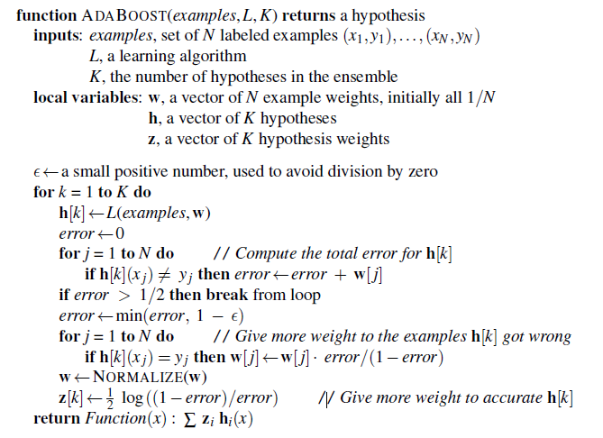
Ensemble Learning
The ADABOOST variant of the boosting method for ensemble learning. The algorithm generates hypotheses by successively reweighting the training examples. The function WEIGHTED-MAJORITY generates a hypothesis that returns the output value with the highest vote from the hypotheses in h, with votes weighted by z. For regression problems, or for binary classification with two classes -1 and 1, this is
∑_{k} ^{h[k]z[k].}

Slide 60

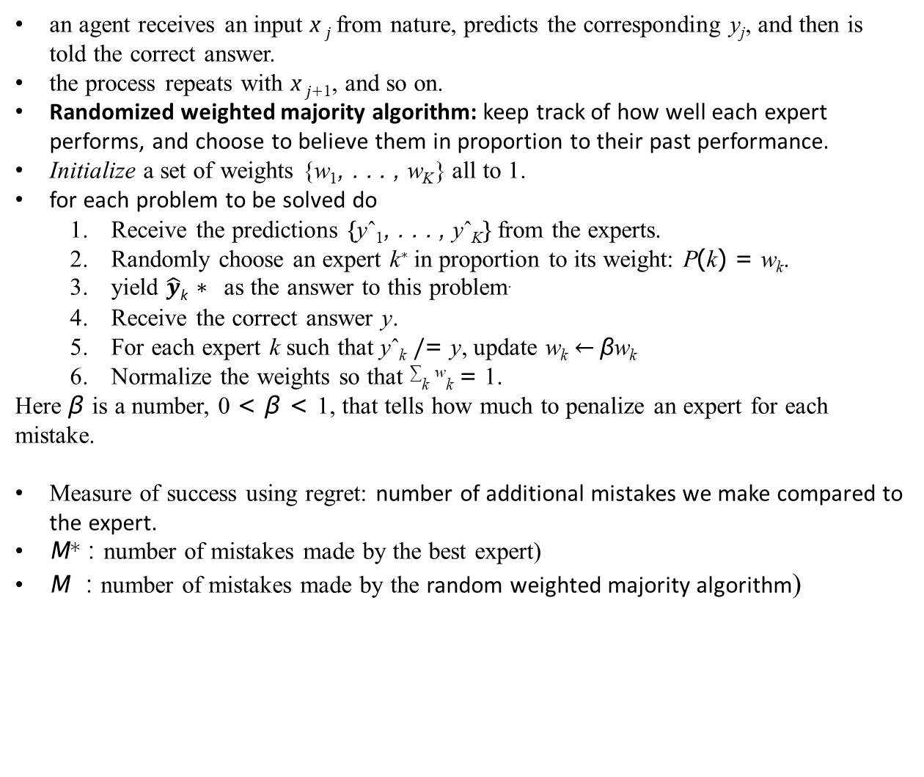
Online Learning
an agent receives an input x _{j} from nature, predicts the corresponding y_{j}, and then is told the correct answer.
the process repeats with x _{j+1}, and so on.
Randomized weighted majority algorithm: keep track of how well each expert performs, and choose to believe them in proportion to their past performance.
Initialize a set of weights {w₁, . . . , w_{K}} all to 1.
for each problem to be solved do
Receive the predictions {yˆ₁, . . . , yˆ_{K}} from the experts.
Randomly choose an expert k∗ in proportion to its weight: P(k) = w_{k}.
yield $\hat{y}$_{k} ∗ as the answer to this problem.
Receive the correct answer y.
For each expert k such that yˆ_{k} /= y, update w_{k} ← βw_{k}
Normalize the weights so that ∑_{k} ^{w}_{k} = 1.
Here β is a number, 0 < β < 1, that tells how much to penalize an expert for each mistake.
Measure of success using regret: number of additional mistakes we make compared to the expert.
M∗ : number of mistakes made by the best expert)
M : number of mistakes made by the random weighted majority algorithm)

Slide 61
Developing Machine Learning Systems
Problem formulation
Determine problem/solution, specify a loss function
metrics that should be tracked
Data collection, assessment, and management
When data are limited, data augmentation can help
For unbalanced class, undersample the majority, over-sample the minority
Consider outliers
Feature engineering, Exploratory data analysis (EDA)
Model selection and training
receiver operating characteristic (ROC) curve
AUC provides a single-number summary of the ROC curv
confusion matrIX
Trust, interpretability, and explainability
Source control Testing Review, Monitoring, Accountability,
Inspect the actual model and understand why it got a particular answer for input
Operation, monitoring, and maintenance
monitor your performance on live data
nonstationarity—the world changes over time

Slide 62
Developing Machine Learning Systems
Tests for Machine Learning Infrastructure
(1) Training is reproducible. (2) Model specification code is unit tested. (3) The full ML pipeline is integration tested. (4) Model quality is validated before attempting to serve it.
(5) The model allows debugging by observing the step-by-step computation of training or inference on a single example. (6) Models are tested via a canary process before they enter production serving environments. (7) Models can be quickly and safely rolled back to a previous serving version.
Monitoring Tests for Machine Learning
(1) Dependency changes result in notification. (2) Data invariants hold in training and serving inputs. (3) Training and serving features compute the same values. (4) Models are not too stale. (5) The model is numerically stable. (6) The model has not experienced regressions in training speed, serving latency, throughput, or RAM usage. (7) The model has not experienced a regression in prediction quality on served data.

Slide 63
Developing Machine Learning Systems
Tests for Features and Data
(1) Feature expectations are captured in a schema. (2) All features are beneficial. (3) No feature’s cost is too much. (4) Features adhere to meta-level requirements. (5) The data pipeline has appropriate privacy controls. (6) New features can be added quickly. (7) All input feature code is tested.
Tests for Model Development
(1) Every model specification undergoes a code review. (2) Every model is checked in to a repository. (3) Offline proxy metrics correlate with actual metrics (4) All hyperparameters have been tuned. (5) The impact of model staleness is known. (6) A simpler model is not better. (7) Model quality is sufficient on all important data slices. The model has been tested for considerations of inclusion.

Slide 64
Summary
If the available feedback provides the correct answer for example inputs, then the learning problem is called supervised learning.
Learning a function whose output is a continuous or ordered value (like weight) is called regression;
Learning a function with a small number of possible output categories is called classification;
Decision trees can represent all Boolean functions. The information-gain heuristic
provides an efficient method for finding a simple, consistent decision tree.
A linear classifier with a hard threshold—also known as a perceptron—can be trained by a simple weight update rule to fit data that are linearly separable.
Logistic regression replaces the perceptron’s hard threshold with a soft threshold defined by a logistic function
Nonparametric models use all the data to make each prediction, rather than trying to summarize the data with a few parameters
Support vector machines find linear separators with maximum margin to improve the generalization performance of the classifier
Ensemble methods such as bagging and boosting often perform better than individual methods.

